Slide 1

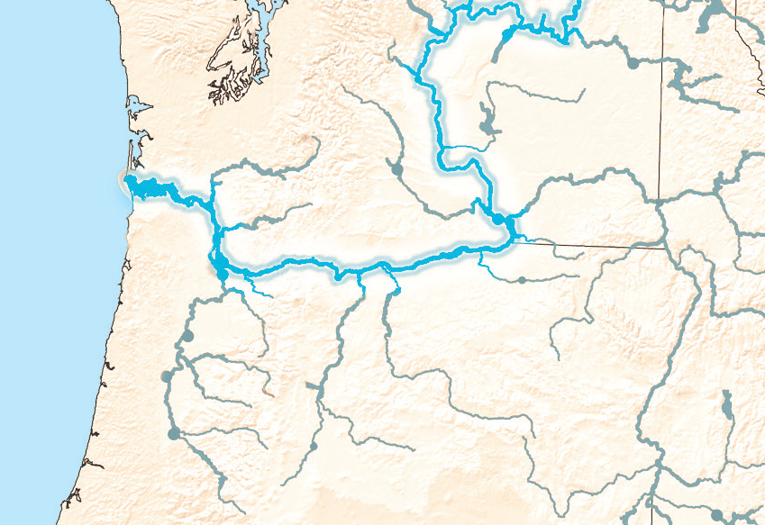

BIG RIVER
WATERSHED
ACTIVITY 2

Slide 2
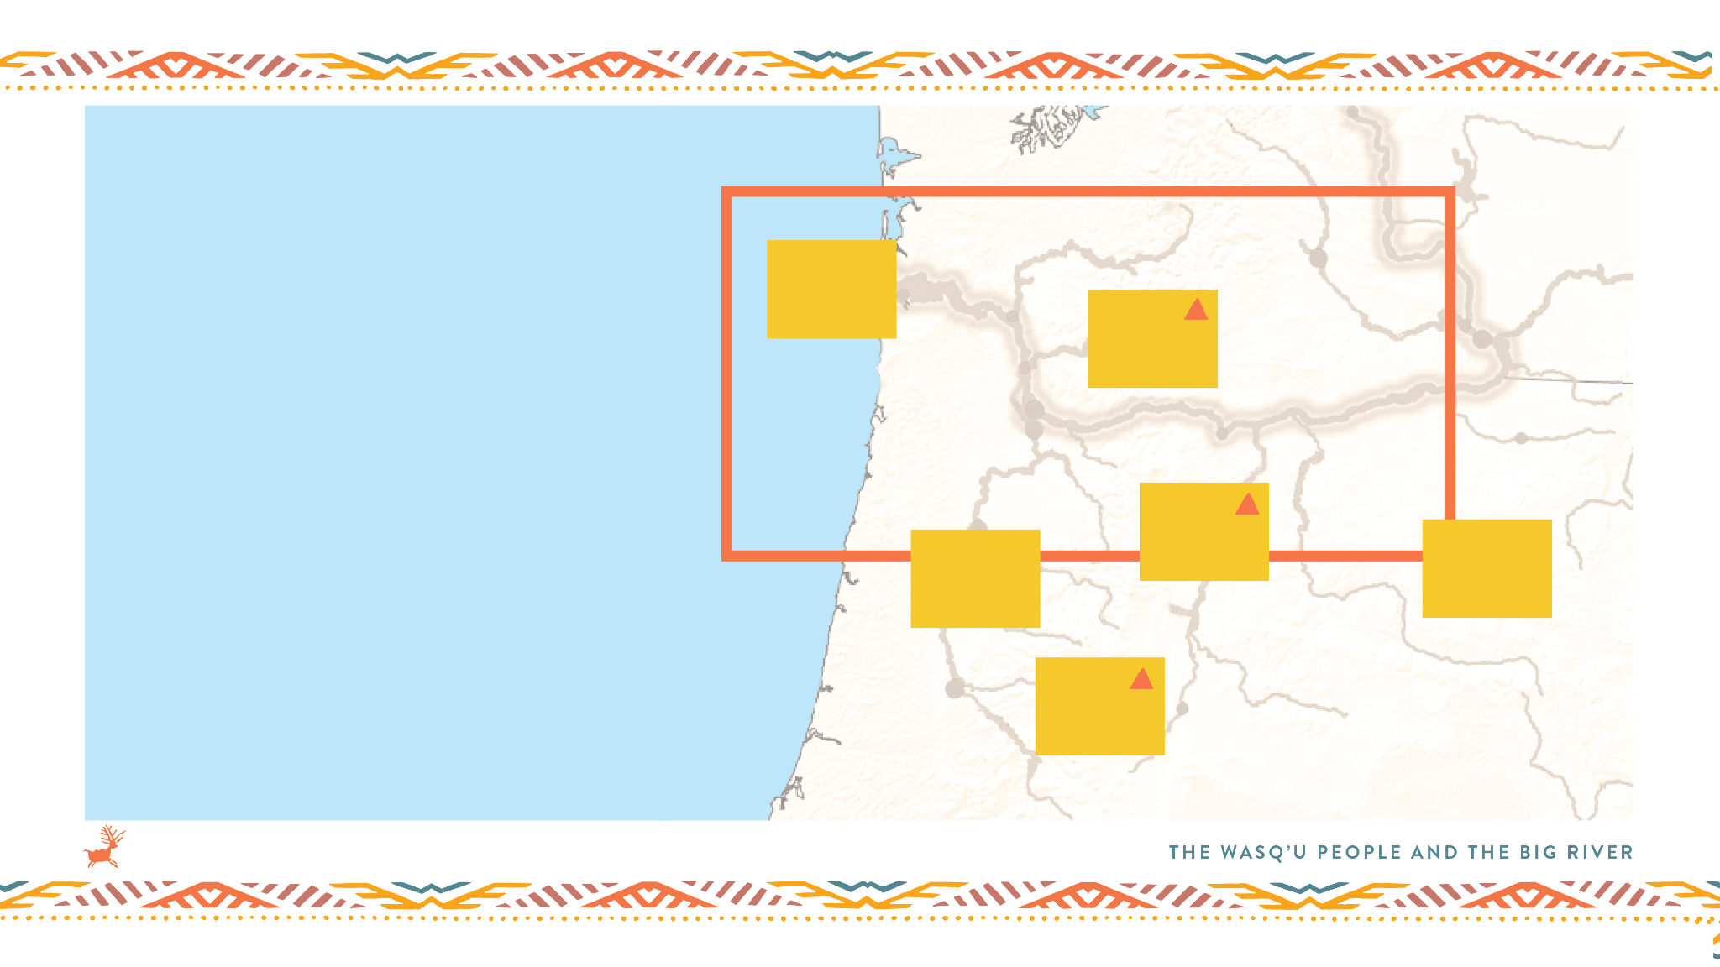
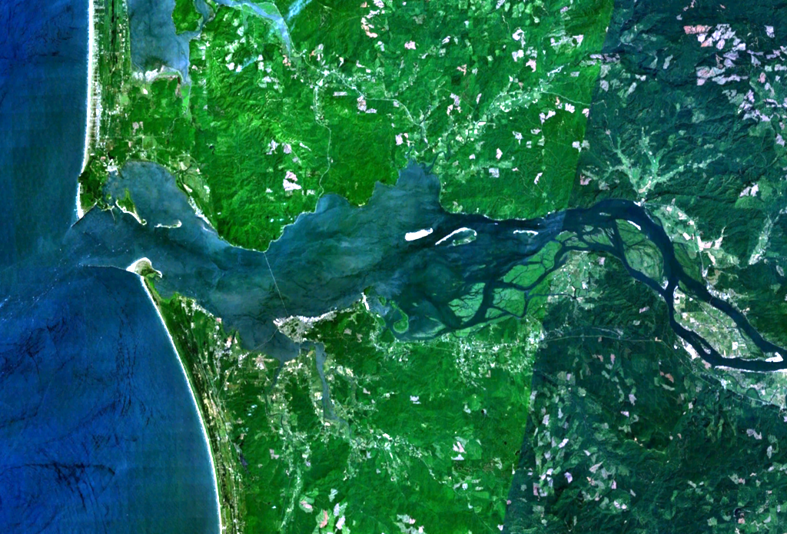


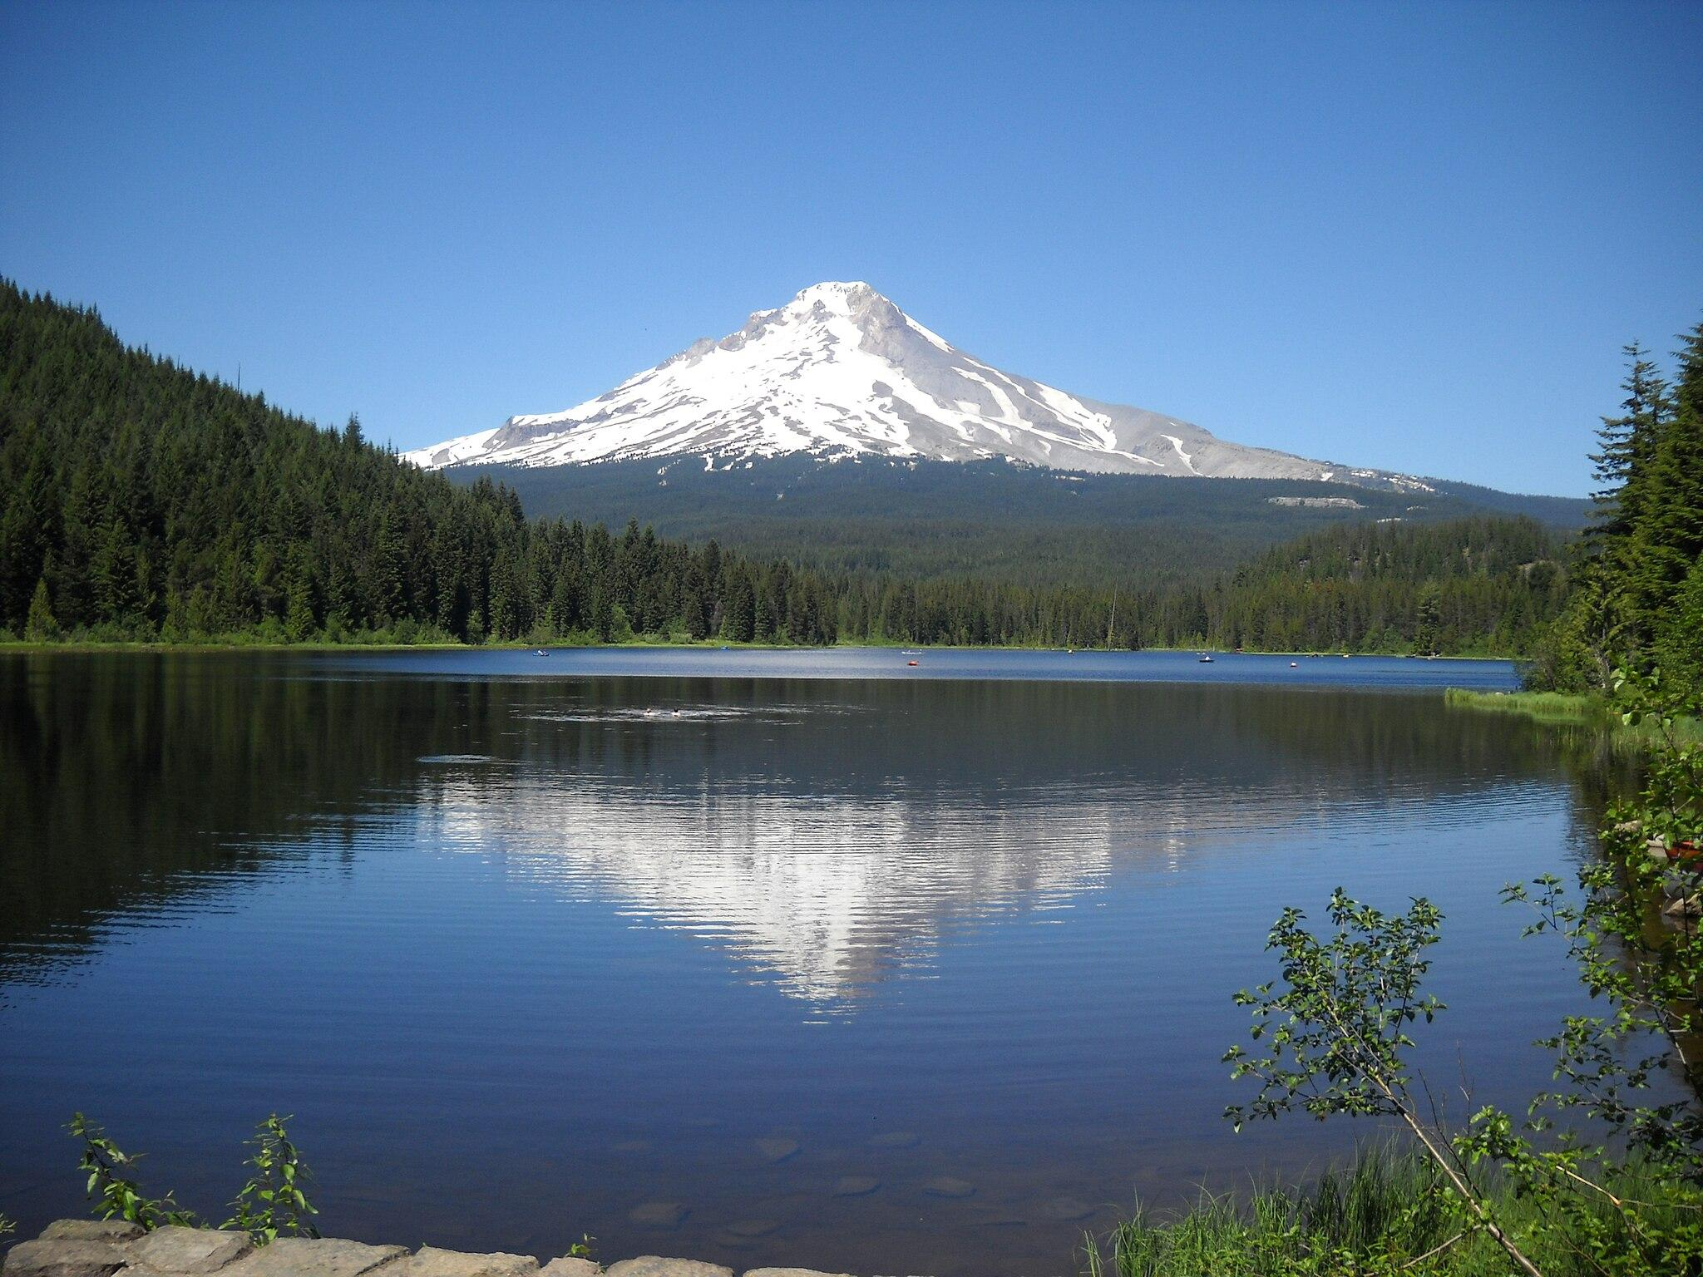


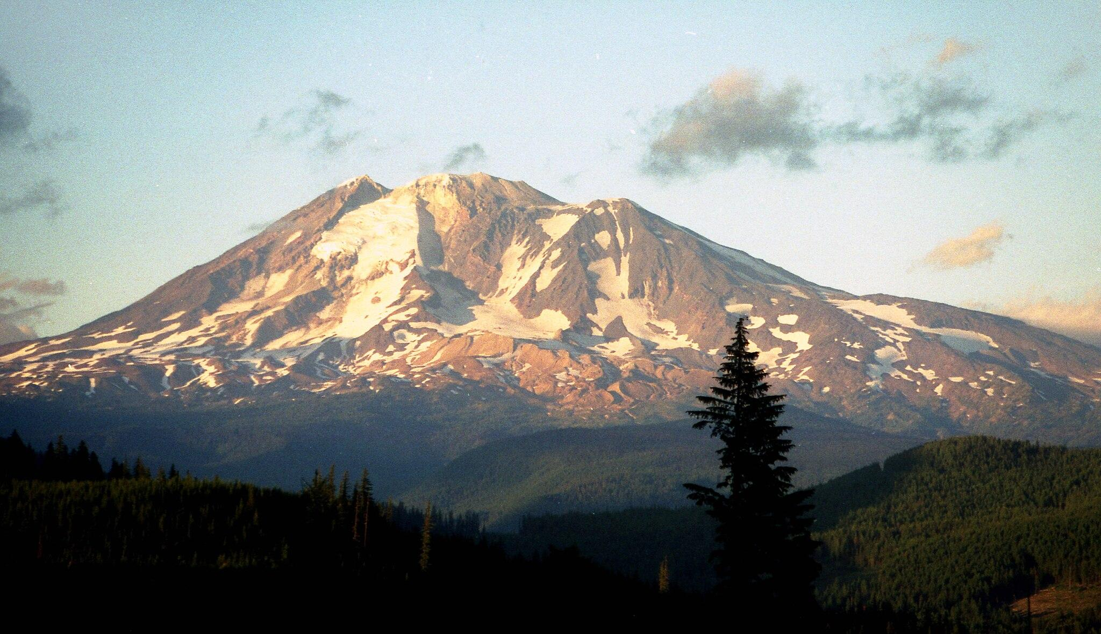


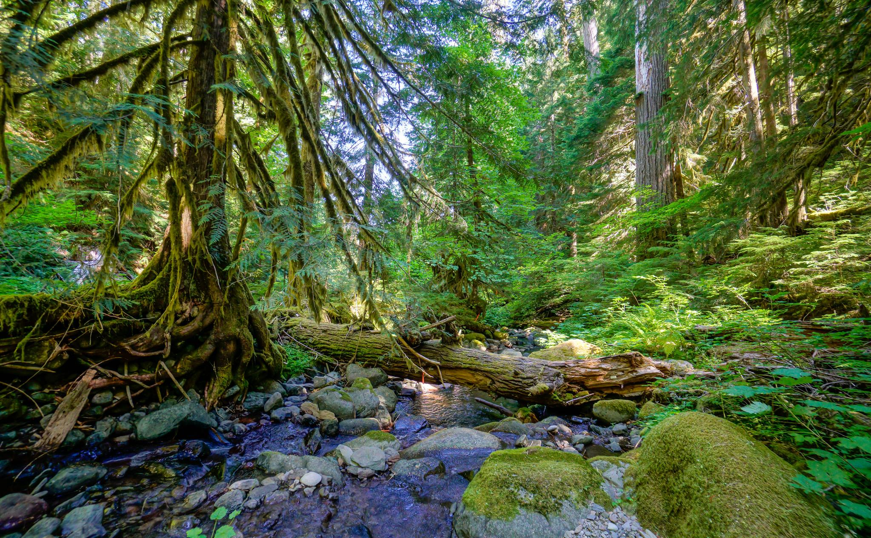

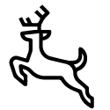
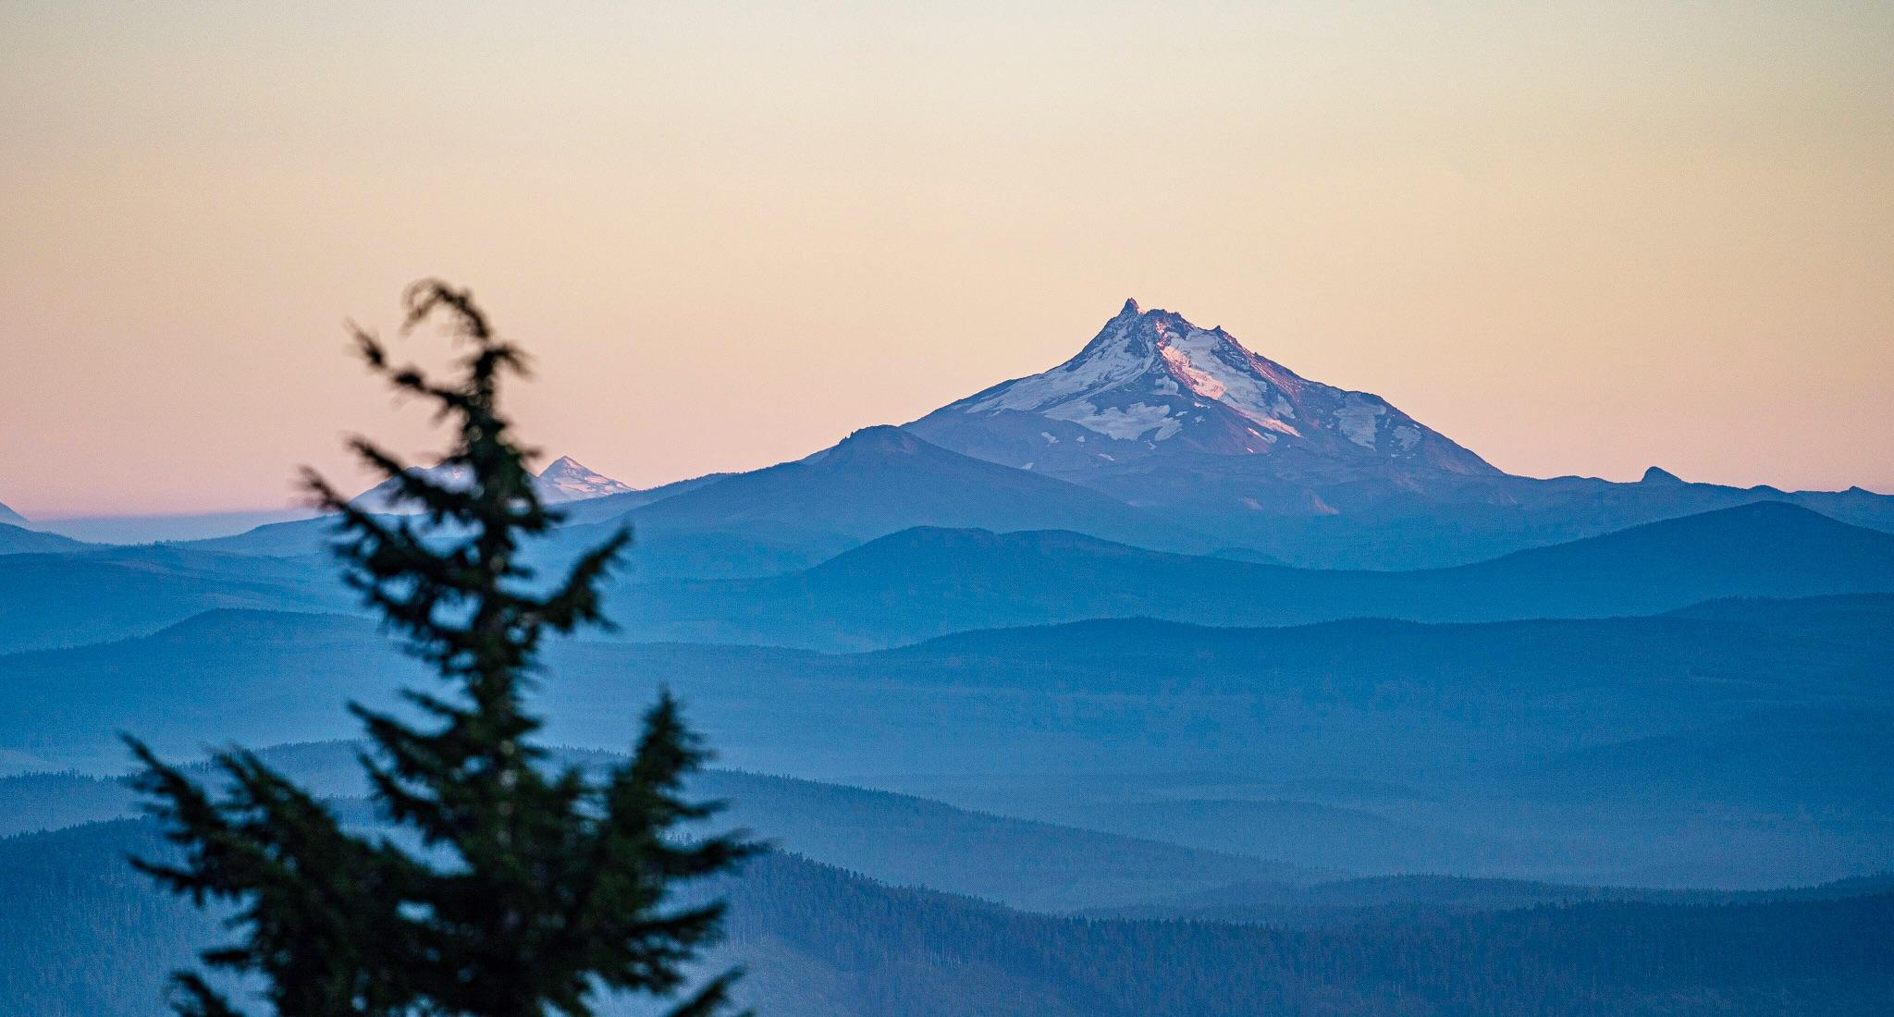
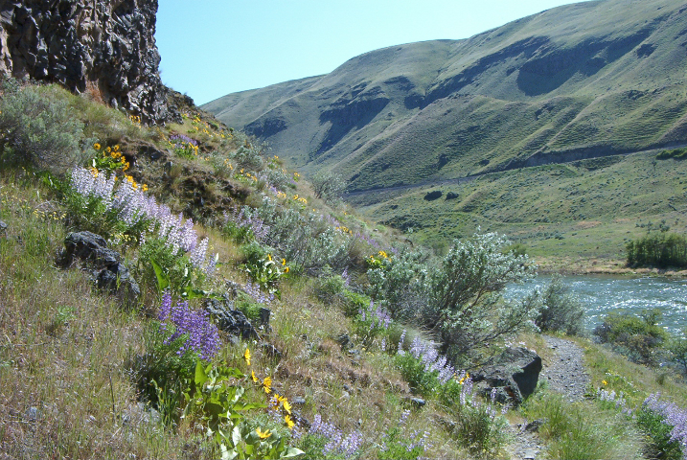
Big River at the Ocean
Mt Hood
Mt Adams
Wet Forest
Mt Jefferson
Select and drag the photos and icons to where these places and gifts are found on the landscape.
High Desert
ACTIVITY 2

Slide 3
Sample
Answer Key
Big River at the Ocean
Mt Adams
Mt Hood
Wet Forest
High Desert
Mt Jefferson
ACTIVITY 2

