Slide 1
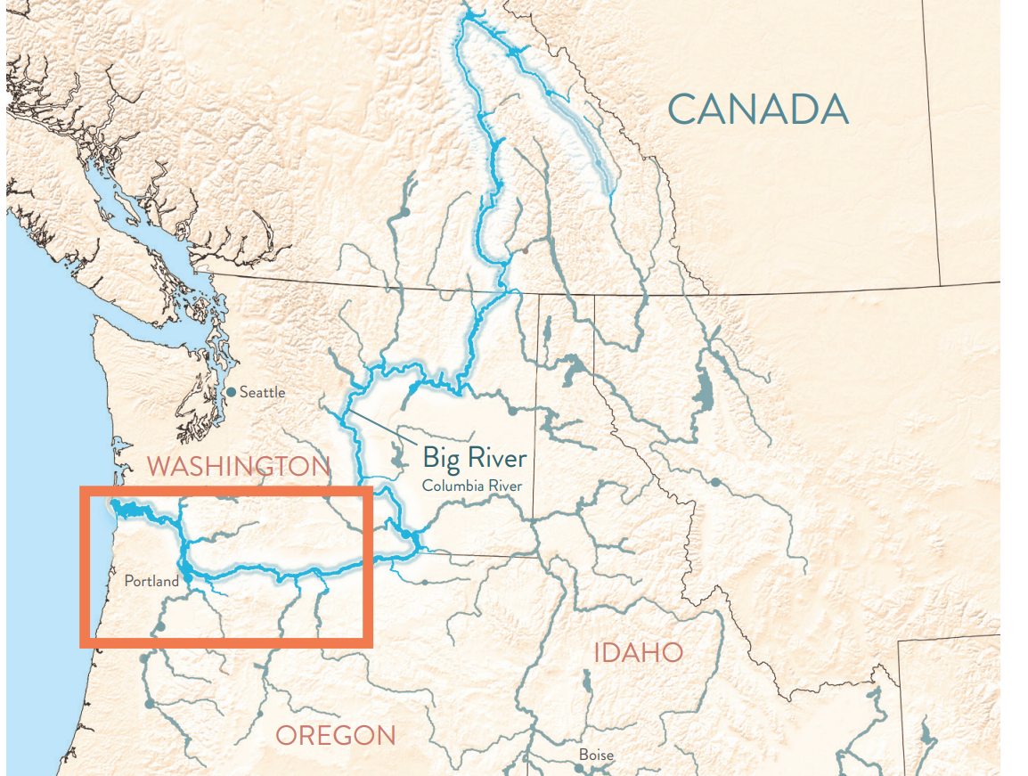
MAP OF THE
NORTHWEST
This map shows the Big River and the many smaller rivers (called tributaries) that feed into it. The red box highlights the homeland of the Wasq’u people along the banks of the Big River.
ACTIVITY 1

